Slide 1

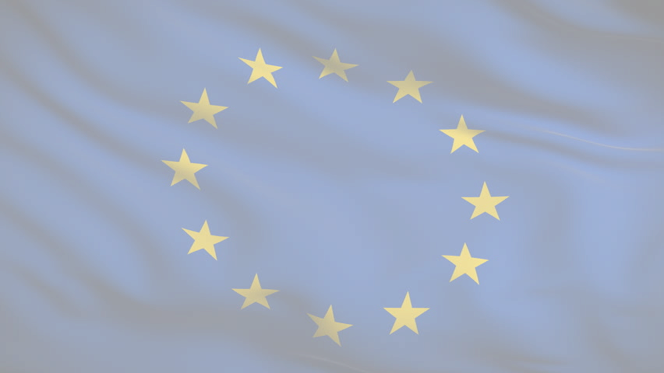


1945-Present
Chapter 31
EUROPEAN INTEGRATION
european integration
Strand Two: The History of Ireland
@MsDoorley

Slide 2
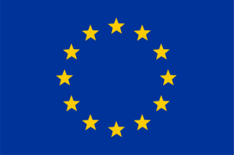
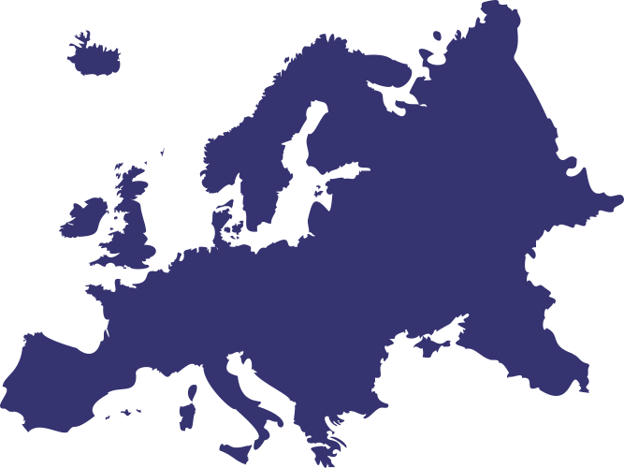
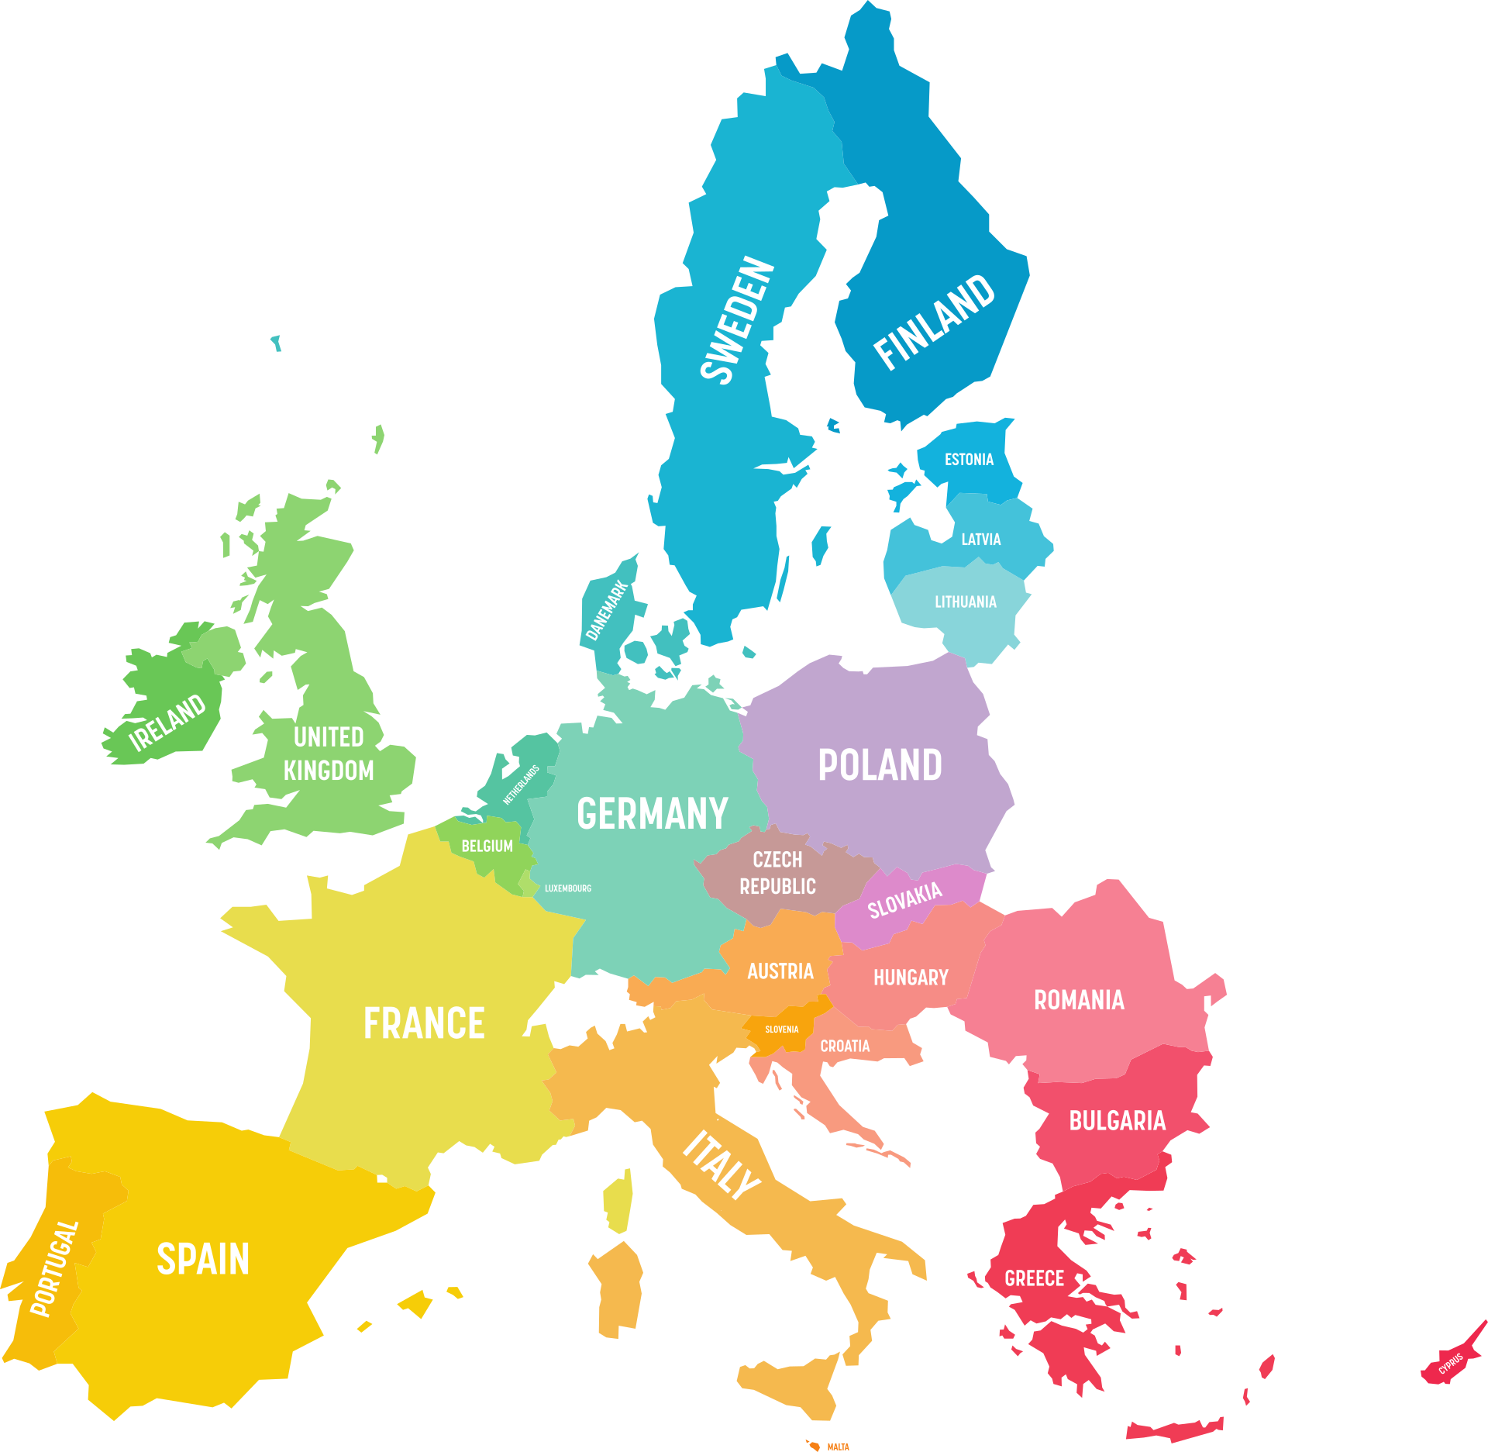

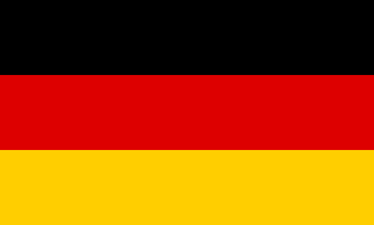

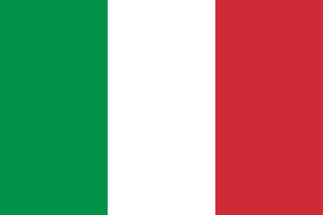
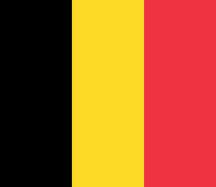

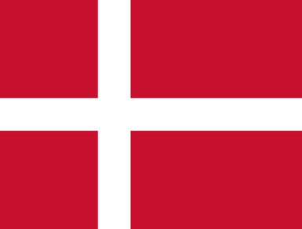


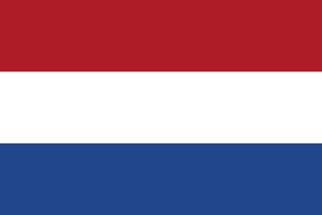
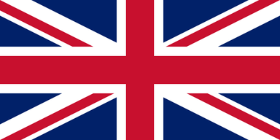
Chapter 31
EUROPEAN INTEGRATION
3.12 EVALUATE the role of a movement or organisation, such as the European Union or United Nations, in promoting international cooperation, justice and human rights
2.13 ANALYSE the evolution and development of Ireland’s links with Europe.
Treaty of Rome creates the European Economic Community
Britain, Denmark and Ireland join the European Community
The Euro is introduced
Strand Two & Three: The History of the World
Chapter Thirty-One: The European Union
1951
1957
1961
1973
1991
2002
2020
Treaty of Paris establishes the ECSC between France, Germany, the Benelux States and Italy
UK, Ireland and Denmark apply for membership of the EEC - UK are vetoed by France, Ireland and Denmark pulls out
The Maastricht Treaty creates the European Union which comes into effect in 1993
The UK vote to leave the EU, officially leaving on the 31st January 2020.
@MsDoorley

Slide 3
Learning Outcomes
2.13 ANALYSE the evolution and development of Ireland’s link with Europe.
3.12 EVALUATE the role of a movement or organisation, such as the European Union or United Nations, in promoting international co-operation, justice and human rights.
Strand Two & Three: The History of the World
Chapter Thirty-One: The European Union
@MsDoorley

Slide 4
Introduction
Europe in 1945 was a devasted continent. World War II had resulted in the deaths of roughly 60 million people in Europe and caused the equivalent of €10 trillion of damage in today's money. As the Cold War developed, Europe was no longer the most powerful continent on Earth and was instead a battleground between superpowers. In the late 1940s, a group of European leaders came together to try to forge a new relationship between their countries, one that would make war a thing of the past.
Strand Two & Three: The History of the World
Chapter Thirty-One: The European Union
@MsDoorley

Slide 5
1945-Present
Chapter 31
31.1: REASONS FOR EUROPEAN INTEGRATION
31.1: reasons for european integration
Strand Two: The History of Ireland
@MsDoorley

Slide 6
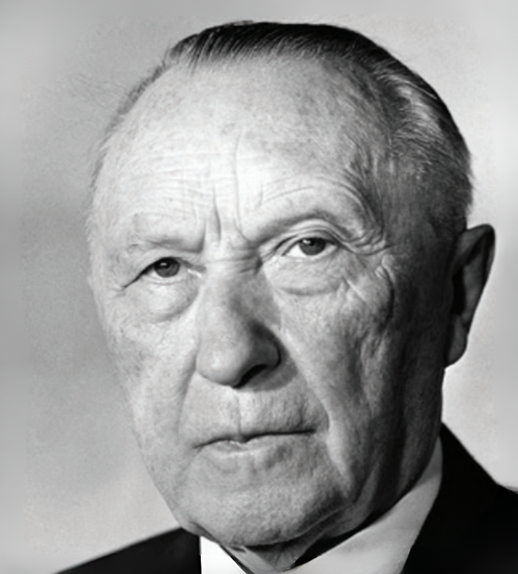
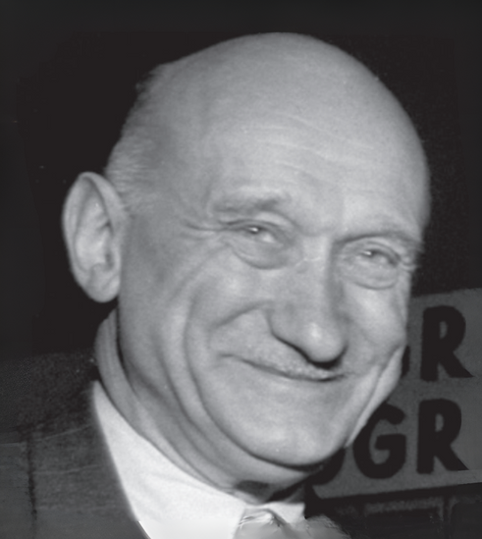
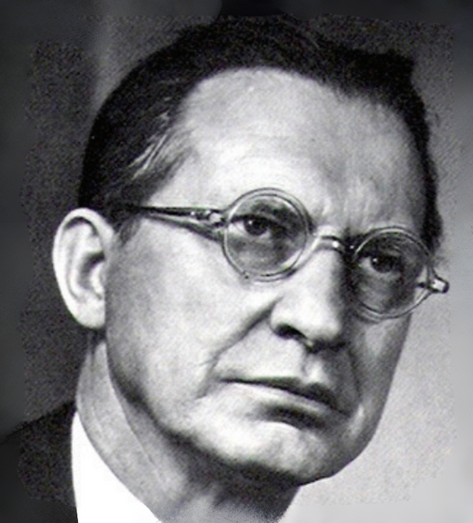
Europe’s post-war leaders
As the Cold War began to take shape, a generation of leaders emerged in Western Europe with one aim – Europe would work together in the future. Many of these leaders had fought in World War II or had spent World War II imprisoned by various Fascist governments. These experiences made them determined to end war and extremism in Europe. This generation of leaders included:
  Konrad Adenauer – Chancellor and Minister for Foreign Affairs (West Germany)
  Robert Schuman – Minister for Foreign Affairs (France)
  Alcide De Gasperi – Prime Minister and Minister for Foreign Affairs (Italy)
Strand Two & Three: The History of the World
Chapter Thirty-One: The European Union
Diagram taken from Artefact, 2nd Edition by Eimear Jenkinson and Gregg O'Neill (educate.ie)
@MsDoorley

Slide 7
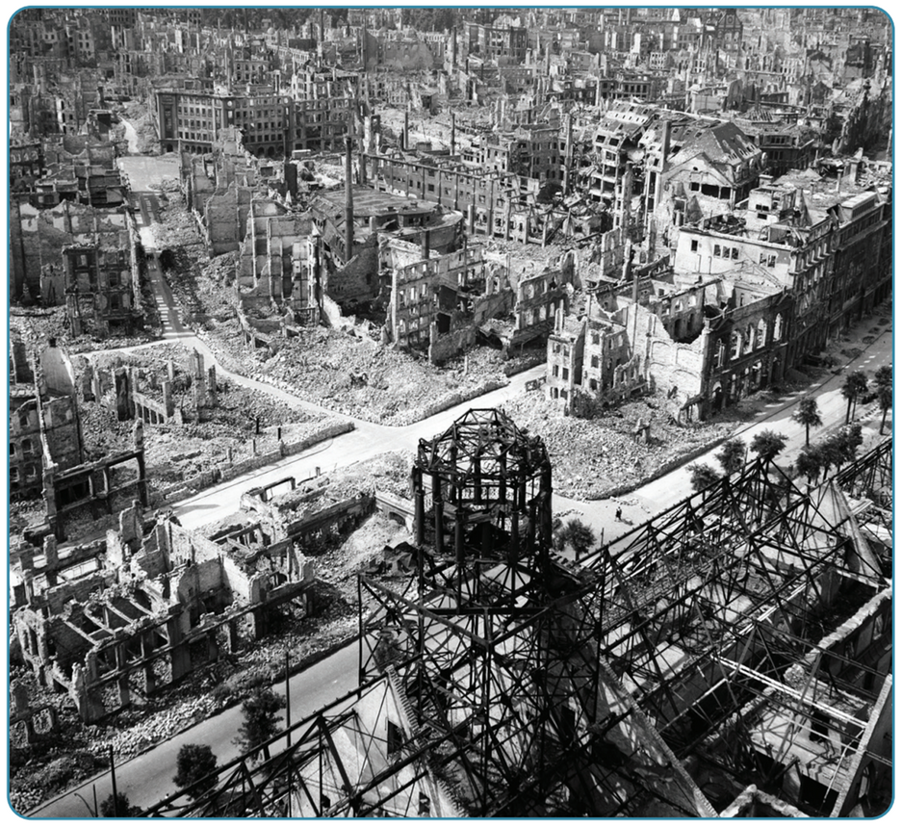
The reasons for European integration
After 1945, a number of factors encouraged the states of Western Europe to work together
1. The legacy of war: War had devasted Europe and killed millions on not one but TWO occasions over the space of 30 years. The legacy had also brought France and Germany together in a way that never happened before.
2. The Cold War: The leaders believed that only an United Europe could compete with the two super powers. As communism spread across Eastern Europe, Western Europe needed to unite to stop a complete takeover.
3. Economics: Europe needed to rebuild after World War II. Trade and cooperation was needed to repair mainland Europe while improving living standards for the people. They did not want a repeat of the growth of Fascism and Nazism.
4. American Support: The US wanted a strong trading partner and ally against communism.
Strand Two & Three: The History of the World
Chapter Thirty-One: The European Union
Diagram taken from Artefact, 2nd Edition by Eimear Jenkinson and Gregg O'Neill (educate.ie)
@MsDoorley

Slide 8
Checkpoint pg. 387 (Artefact, 2nd Edition)
  Why were European leaders determined to work together after World War II?
  How did Europe’s recent past encourage cooperation after 1945?
  What role did Europe’s post-war problems play in bringing the continent together?
  Look at the list of reasons for European integration. Which of them do you think is the most important? Explain your answer.
Strand Two & Three: The History of the World
Chapter Thirty-One: The European Union
@MsDoorley

Slide 9
1945-Present
Chapter 31
31.2: THE FIRST STEPS TOWARDS EUROPEAN INTEGRATION
31.2: the first steps towards european integration
Strand Two: The History of Ireland
@MsDoorley

Slide 10
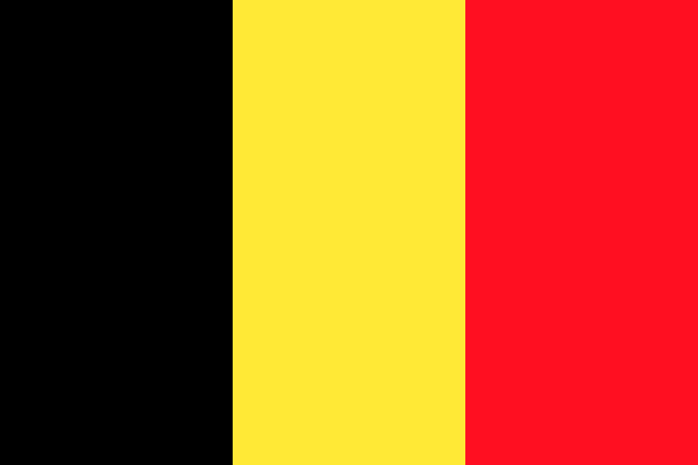
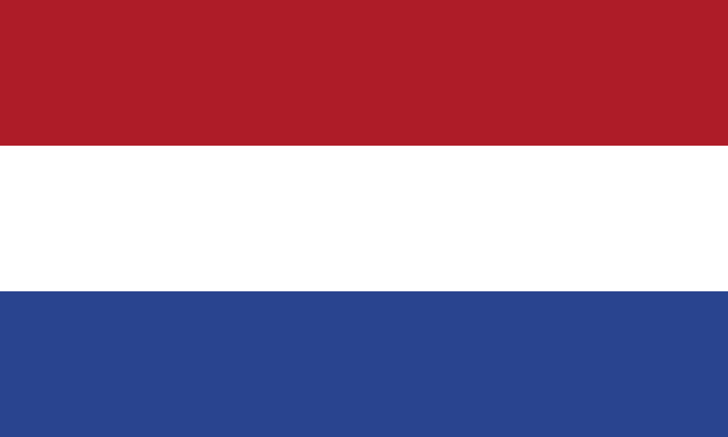

The Benelux Agreement, 1947
European integration was a gradual process. Different areas were picked to start the plans for working together. The first of these came in 1947; Belgium, the Netherlands and Luxembourg agreed to abolish all custom duties on import/exports between them. This was known as the Benelux Union (Be + Ne + Lux). It was a huge success – by 1957, trade amongst them had tripled.
Strand Two & Three: The History of the World
Chapter Thirty-One: The European Union
@MsDoorley

Slide 11
The Organisation for European Economic Co-Operation (OEEC) 1948
Set up in 1948 at the insistence of the USA, the OEEC was responsible for the administration of the Marshall Plan funds to Europe. It demonstrated the advantages of economic integration and cooperation in order to generate economic growth and raise living standards.
Strand Two & Three: The History of the World
Chapter Thirty-One: The European Union
@MsDoorley

Slide 12
The Council of Europe, 1949
In 1948, leaders of Western European states met at the Hague Congress. The following year, they set up the Council of Europe in Strasbourg (they still meet here). The Council included ten states. It was set up to promote common ideas and values, and to further European unity amongst its members.
Its most important action was to pass the European Convention on Human Rights (ECHR) and set up the European Court of Human Rights (HCtHR) to rule on it. The Convention guaranteed the basic human rights of all citizens in Europe to democracy, free speech, free Media, and protection from torture or unfair trials. If a citizen felt their rights had been violated by their own government, they could take a case to the European Court of Human Rights.
Strand Two & Three: The History of the World
Chapter Thirty-One: The European Union
This was to protect the citizens of Europe from any future actions that would replicate Hitler and Nazi attempts to eradicate the Jews during the Holocaust.
@MsDoorley

Slide 13
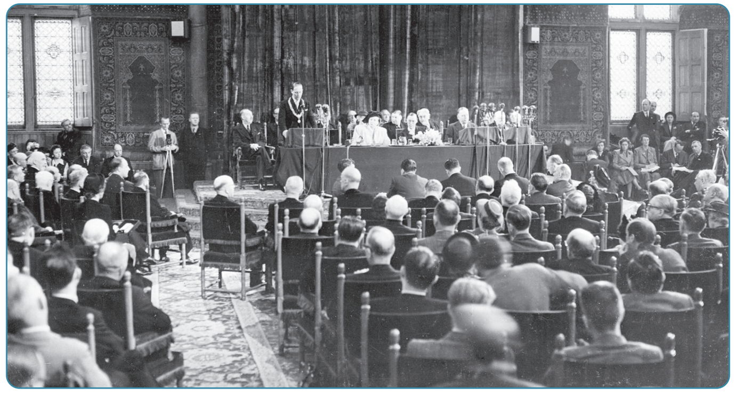
Strand Two & Three: The History of the World
Chapter Thirty-One: The European Union
Diagram taken from Artefact, 2nd Edition by Eimear Jenkinson and Gregg O'Neill (educate.ie)
@MsDoorley

Slide 14
The North Atlantic Treaty Organisation
The North Atlantic Treaty Organization (NATO) is a military alliance. The founding states were: The United States, Belgium, the Netherlands, Luxembourg, France, the United Kingdom, Canada, Portugal, Italy, Norway, Denmark and Iceland. It was established by the North Atlantic Treaty in 1949 and it was signed in Washington, D.C., USA, on April 4, 1949 while its headquarters are in Brussels, Belgium. There are now 30 official member states – Ireland joined as an observer in 2020.
Strand Two & Three: The History of the World
Chapter Thirty-One: The European Union
@MsDoorley

Slide 15
European Coal and Steel Community (ECSC), 1952
The ECSC was the most important step towards European unity. By 1950, there was a growing concern in France about the emergence of West German as a powerful state in Europe. In order to minimise this potential threat, Robert Shuman put forward the Shuman Plan. He proposed that the coal and steel industries of France and Germany would be put under a single High Authority. Integrating these industries would make ‘war not only unthinkable but materially impossible’.
The Schuman Plan led to the Treaty of Paris in 1951. This was signed by West Germany, France, Italy and the Benelux countries. Beginning in 1952, it was a huge success. Steel production increased significantly and industrial production grew at twice the previous rate. It was the FIRST TIME that these states had agreed to hand over some sovereignty to an outside body. Sovereignty is a country’s independence and power, so deciding to share it was a huge step forward. The ECSC could make decisions that would be binding on all its members.
Strand Two & Three: The History of the World
Chapter Thirty-One: The European Union
@MsDoorley

Slide 16
Checkpoint pg. 389 (Artefact, 2nd Edition)
  Why do you think the Benelux Agreement was important in the story of European integration?
  What was the function of OEEC?
  What was the European Convention on Human Rights and why was it important?
  Why did the French propose setting up the ECSC?
  What was the ECSC?
  How was it different from the bodies that had gone before it?
Strand Two & Three: The History of the World
Chapter Thirty-One: The European Union
@MsDoorley

Slide 17
1945-Present
Chapter 31
31.3: THE EUROPEAN ECONOMIC COMMUNITY
31.3: the european economic community
Strand Two: The History of Ireland
@MsDoorley

Slide 18
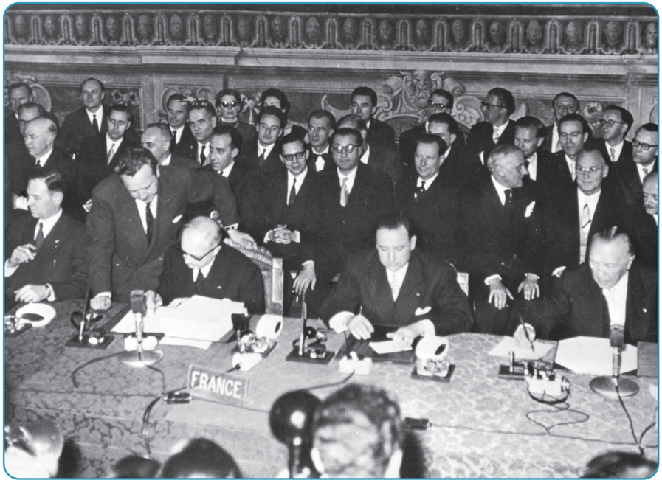
The Treaty of Rome, 1957
By the late 1950s, given the success of the ECSC, it seemed natural to extend its principles to other economic areas. The six members signed the Treaty of Rome in 1957. The European Economic Community came into being on 1st January 1958. It had three core aims:
  To promote economic activity.
  To raise the standard of living.
  To forge ‘an ever closer union among the peoples of Europe’.
Strand Two & Three: The History of the World
Chapter Thirty-One: The European Union
Diagram taken from Artefact, 2nd Edition by Eimear Jenkinson and Gregg O'Neill (educate.ie)
@MsDoorley

Slide 19
The structure of the EEC
The EEC had a complicated institutional organisation designed to implement the Treaty of Rome and also to grow and adapt in the decades that followed. These three bodies make up the very important 'institutional triangle';
The Commission: runs the EEC day to day and implements the treaties. It is made up of nominees of the member states - the commissioners.
The Council of Ministers: national ministers meet regularly to discuss common issues and make decisions.
The European Parliament: intended to represent the people of Europe. Its members were initially nominated by national parliaments but since 1979, they have been directly elected by the people. At first, it had very limited powers but it has grown over time to have equal powers with the Commission and Council.
Various other bodies play important roles, for instance:
The Court of Justice: rules on interpretations of the treaties and on disputes between other institutions and member states.
Strand Two & Three: The History of the World
Chapter Thirty-One: The European Union
@MsDoorley

Slide 20
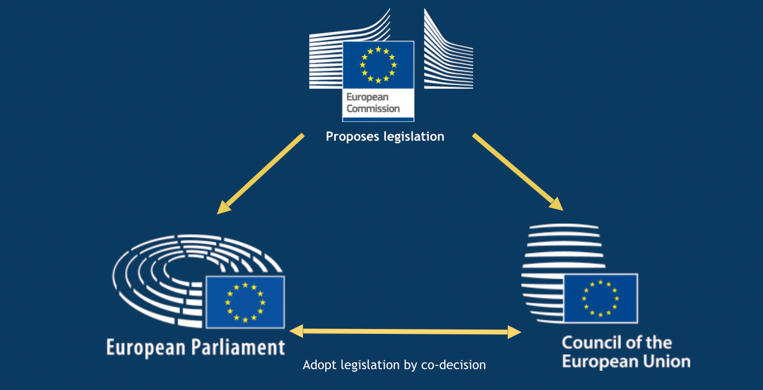
Strand Two & Three: The History of the World
Chapter Thirty-One: The European Union
Diagram taken from Artefact, 2nd Edition by Eimear Jenkinson and Gregg O'Neill (educate.ie)
@MsDoorley

Slide 21
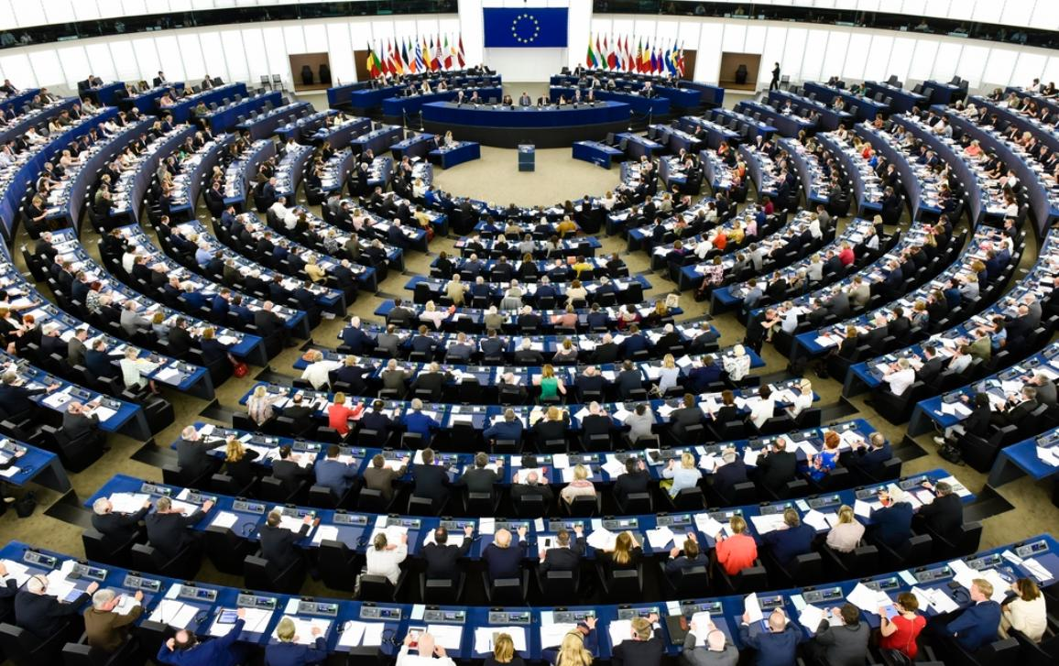
Strand Two & Three: The History of the World
Chapter Thirty-One: The European Union
@MsDoorley

Slide 22
Main policies of the EEC
To fulfil its aims, the EEC's institutions would implement a set of policies agreed in the Treaty of Rome:
  Common market: A free trade area by eliminating restrictions (tariffs, custom duties) on trade on all goods amongst members. It would also have common external tariffs for goods coming into the free trade area. The intention was to increase trade between members and therefore help them grow their economies.
  Freedom of movement: removal of restrictions on the movement of money, people, goods and services amongst member states. These are known as the 'Four Freedoms'.
  Common Agricultural Policy (CAP): to guarantee the price paid to farmers for their produce and set high standards of quality.
  Investment Fund: to improve less-developed areas of the EEC through funding from richer members.
Strand Two & Three: The History of the World
Chapter Thirty-One: The European Union
@MsDoorley

Slide 23
Checkpoint pg. 391 (Artefact, 2nd Edition)
  Why did the six members of the ECSC decide to set up the European Economic Community?
  What is the function of each of the following institutions: (a) the Commission; (b) the Council of Ministers; (c) the European Parliament; (d) the Court of Justice?
  What is the common market?
  What are the ‘Four Freedoms’?
  How do you think the 'Four Freedoms' would help bring the member states together?
Strand Two & Three: The History of the World
Chapter Thirty-One: The European Union
@MsDoorley

Slide 24
1945-Present
Chapter 31
31.4: THE DEVELOPMENT OF EUROPEAN INTEGRATION AFTER 1958
31.4: the development of european integration after 1958
Strand Two: The History of Ireland
@MsDoorley

Slide 25
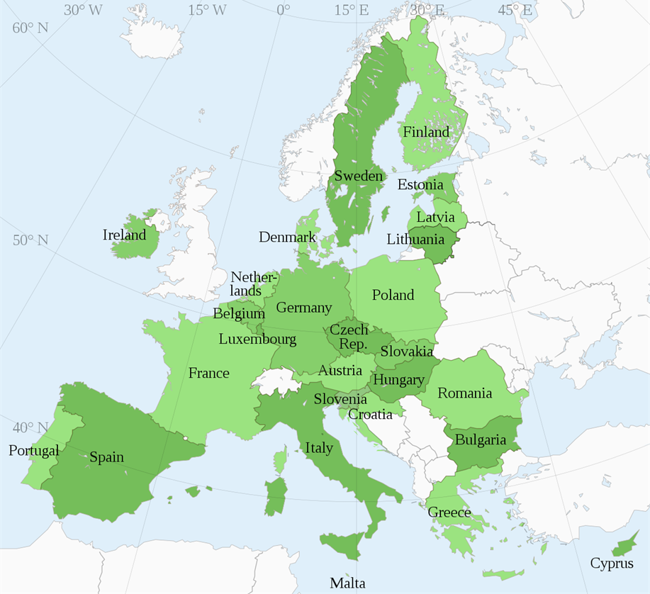
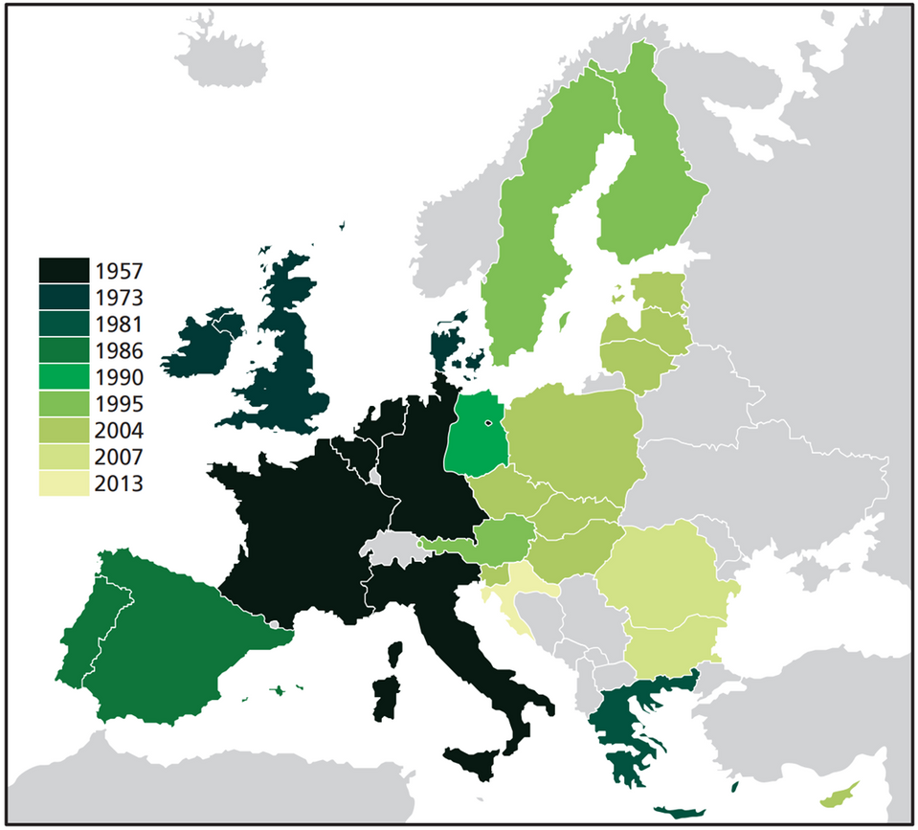
Strand Two & Three: The History of the World
Chapter Thirty-One: The European Union
The members of the European Union
On the left, all 27 states as of May 2021
On the right, including the United Kingdom, when each country joined the EU
Diagram taken from Artefact, 2nd Edition by Eimear Jenkinson and Gregg O'Neill (educate.ie)
@MsDoorley

Slide 26
Enlargement
•The EEC was a tremendous success. By 1973, the economies of the six states had grown by 50% and their unemployment had been halved. This led to other states deciding they wanted to participate and enjoy the same benefits. The European Community (EC), as it was called by the 1990s, gradually grew over the following decades:
  1973: Britain, Ireland and Denmark
  1981: Greece's dictatorship fell in the late 1970s, allowing it to join the EC.
  1986: Portugal and Spain joined the EC, having likewise become democrats in the 1970s.
  1995: Austria, Sweden and Finland.
  2004: Poland, the Czech Republic, Slovakia, Estonia, Latvia, Lithuania, Hungary, Slovenia, Malta and Cyprus
  2007: Romania and Bulgaria
  2013: Croatia
The expansion of the EC in the 1990s and 200s came as a result of the end of the Cold War. After the sudden collapse of communism in Central and Eastern Europe collapsed, the EC supported the states with loans, stabilising their economies and promised a path to future membership of the EC once they kept their commitments to democracy and human rights.
Strand Two & Three: The History of the World
Chapter Thirty-One: The European Union
Did You Know?
Norway applied in both 1973 and 1995 but its people voted against memberships on both occasions. This makes it the only country to turn down the opportunity to enter the European Community.
@MsDoorley

Slide 27
From Community to Union
The Treaty of Rome has been revised several times since it was signed. These changes allowed the European institutions the flexibility to cope with more members, increase their powers and give them new responsibilities.
The Single European Act, 1986
The aim of this treaty was to create the Single Market; a single economic area that would remove all remaining barriers to movement of money, people, goods and services amongst the member states.
The Maastricht Treaty, 1992
Strand Two & Three: The History of the World
Chapter Thirty-One: The European Union
In the early 1990s, the leaders of the EEC such as the German Chancellor Helmut Kohl and the French President François Mitterrand supported further integration. They led the negotiations on a new treaty to respond to the problems of post-Cold War world. The Maastricht Treaty (1992) was a significant move towards full European unity. The treaty:
  Created the European Union (EU).
  Established the rules for a single currency, the euro (€), which was introduced in 2002.
  Remove the right of states to veto things in many areas.
  Gave more power to the European Parliament.
  Created the Social Charter to increase the rights and protections of workers.
@MsDoorley

Slide 28
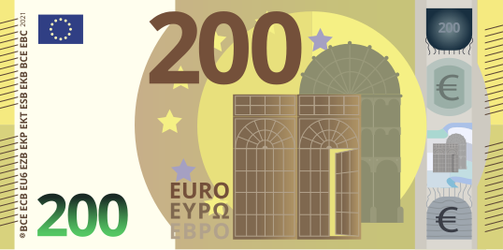
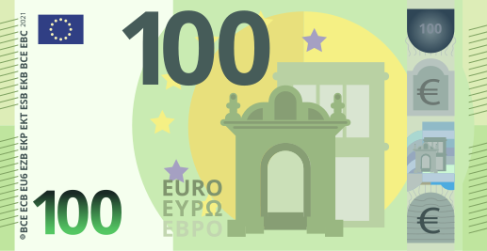
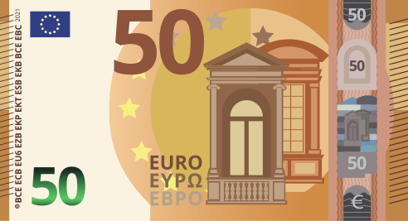
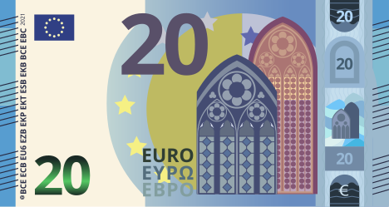
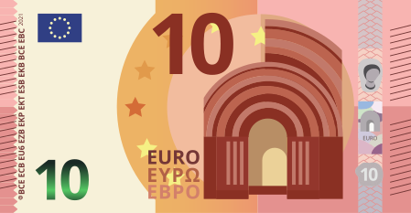
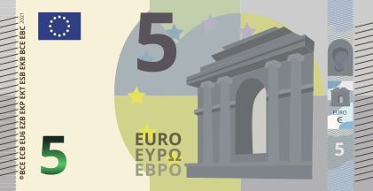
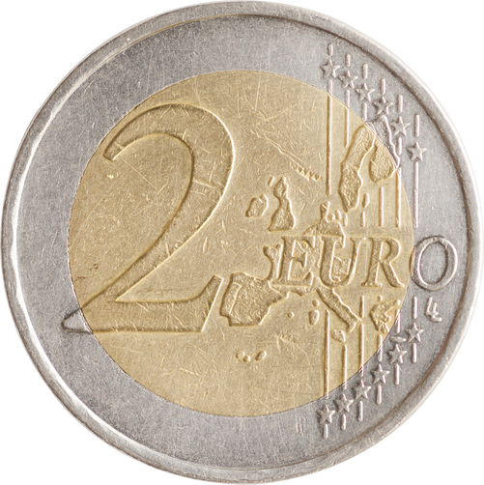
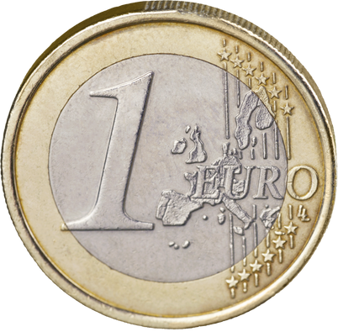
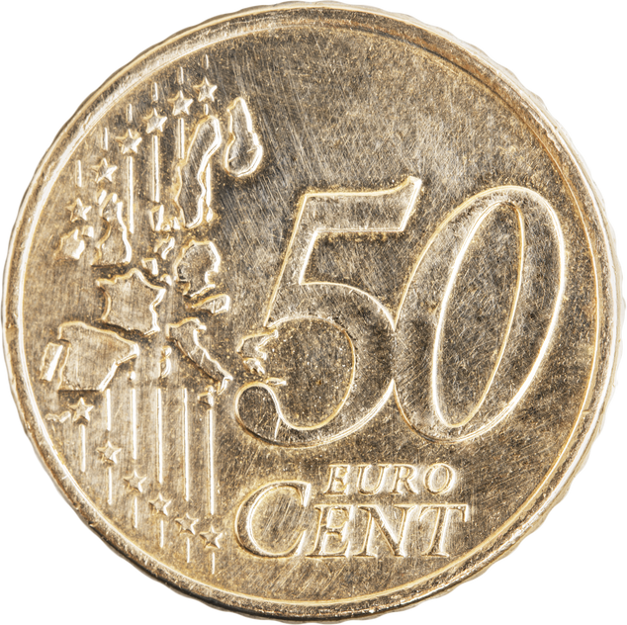
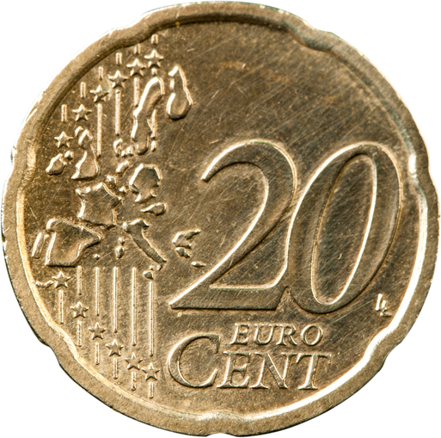
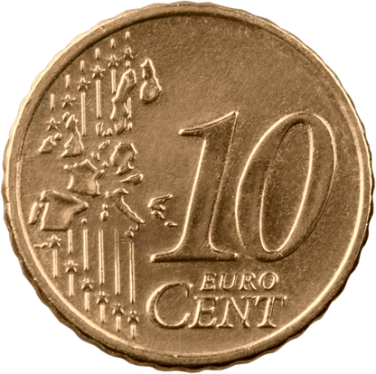
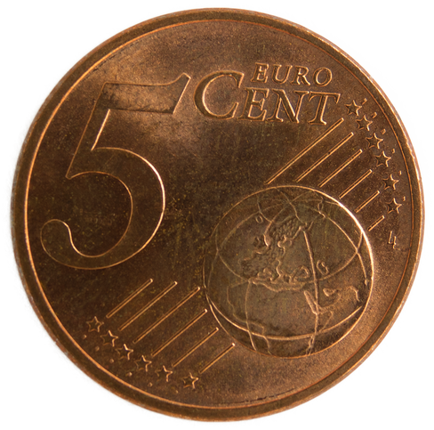
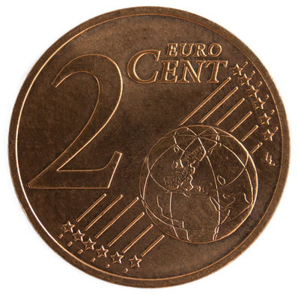
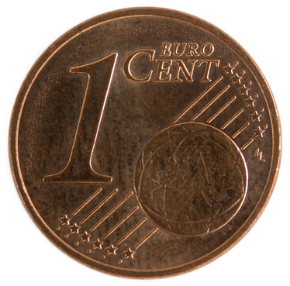
Strand Two & Three: The History of the World
Chapter Thirty-One: The European Union
@MsDoorley

Slide 29
Successes
Problems
  It achieved its fundamental aim; peace has been maintained in Europe.
  Prosperity in Europe increased significantly – standards of living had improved significantly.
  The EU’s membership grew from 6 to 28, now 27.
  It’s the largest trading block in the world.
  Social and structural funding of over €1 trillion has been spent to improve the economic conditions in the poorer areas of Europe.
  Workers have better protections including minimum wages, equal pay, maximum working ours and health/safety measures.
  Europe is more prosperous, equal and united than ever in its history.
  Many people feel that the EU has moved further away from the people it governs and lacks democracy in much of its institutions.
  Some people feel that they are losing their unique national identities within the EU.
  The EU has failed to develop a common foreign policy.
  Member states sometimes feel they are forced to do things against their will.
  A large cap still exists between the richest and poorest member states.
Strand Two & Three: The History of the World
Chapter Thirty-One: The European Union
@MsDoorley

Slide 30
The UK leave the EU
In 2016, the UK held a referendum on whether it should remain in the EU. The issue became known as “Brexit” – the British Exit. The result surprised a lot of people; overall, 51.9% of UK voters voted to leave the EU (primarily in the old coal and steel mining areas in North England). However, those in London, Scotland and Northern Ireland voted overwhelmingly to stay. Particular tensions have arisen over the possibility of a new border dividing the Republic of Ireland and Northern Ireland; just two decades after the Good Friday Agreement Ended the Troubles.
Strand Two & Three: The History of the World
Chapter Thirty-One: The European Union
@MsDoorley

Slide 31
Checkpoint pg. 394 (Artefact, 2nd Edition)
  How did the EC help the countries in Central and Eastern Europe after communism collapsed?
  What was agreed in the Single European Act?
  Name three things the Maastricht Treaty changed.
  Name three successes of the EU.
  Name three areas where the EU has failed or has problems.
  On balance, do you believe that the EU is a success or a failure? Give reasons for your answer.
Strand Two & Three: The History of the World
Chapter Thirty-One: The European Union
@MsDoorley

Slide 32
1945-Present
Chapter 31
31.5: IRELAND AND EUROPEAN INTEGRATION
31.5: ireland and european integration
Strand Two: The History of Ireland
@MsDoorley

Slide 33
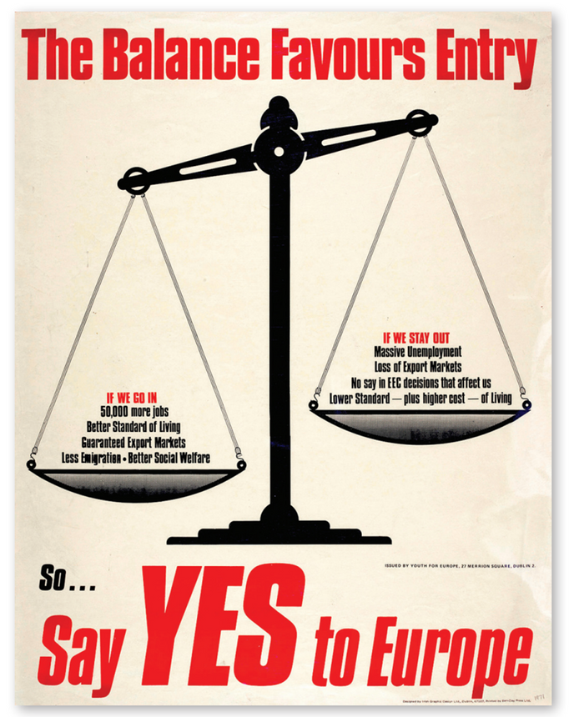
Joining Europe
Ireland had joined the OEEC in 1948 and the Council of Europe in 1949. Post World War II Irish governments saw these European bodies as a way for Ireland to reengage with the international community after the isolation of neutrality during WWII. Ireland in the 1950s followed a protectionist economic policy; they were still a relatively young state. They were not invited to join either the European Coal and Steel Community in 1952 or the European Economic Community in 1957.
Seán Lemass changed Irish economic policy to favour exports and trade but realised that Ireland could only join the EEC if Britain did. This was due to Britain being Ireland’s largest trading partner. When Britain applied in 1961, so did Ireland. However, the French President, Charles de Gaulle, believed Britain was too close to the US and the Commonwealth – this led to him vetoing (blocking) their application in 1963. With their largest trading partner blocked, both Ireland and Denmark withdrew their applications. After de Gaulle left office in 1969, they tried again. This time, they were successful and the three states joined in 1973, making the European Community(EC), as it was now known, a nine-member club.
Strand Two & Three: The History of the World
Chapter Thirty-One: The European Union
Diagram taken from Artefact, 2nd Edition by Eimear Jenkinson and Gregg O'Neill (educate.ie)
@MsDoorley

Slide 34
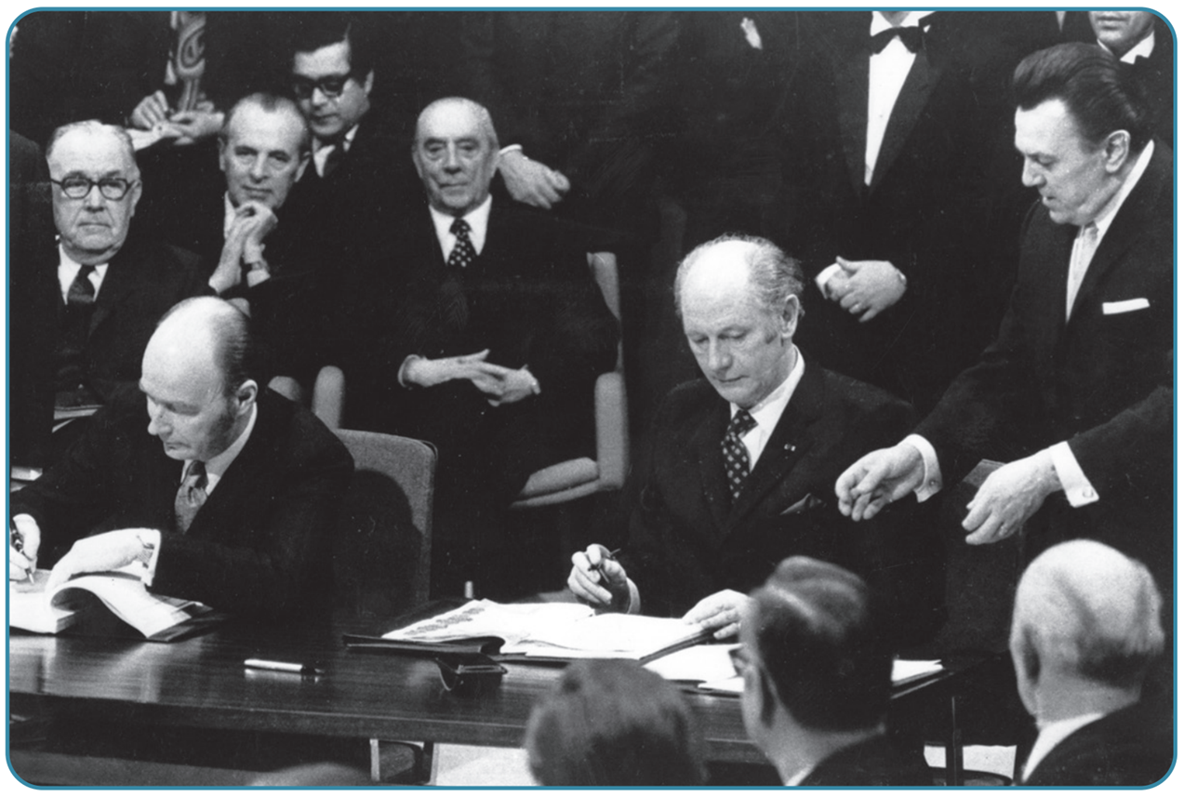
Strand Two & Three: The History of the World
Chapter Thirty-One: The European Union
Diagram taken from Artefact, 2nd Edition by Eimear Jenkinson and Gregg O'Neill (educate.ie)
@MsDoorley

Slide 35
The impact on Ireland
Ireland has benefited significantly from European Union membership. For the first thirty years of its membership, Ireland was one of the poorest states and therefore received a lot of European funding. Some of the benefits include:
  Irish business having access to a market of over 510 million people; Irish trade is 150 times what it was in 1973.
  Irish citizens can move, work and live within any of the other member states.
  Between 1973 and 2015, Ireland received €74.3 billion from the EU; most of this used to build infrastructure (the motorways) around the country.
  Between 1973 and 2014, Irish farmers have received €54 billion from the CAP.
  The EU helped foster peace in Northern Ireland through financial support and investment in cross-border programmes.
  Irish people have benefited from EU laws in areas such as equal pay for women, workers’ rights and consumer safety.
  Some Irish industries have not been able to survive the competition as part of the Single Market, such as car and sugar manufacturing.
Strand Two & Three: The History of the World
Chapter Thirty-One: The European Union
@MsDoorley

Slide 36
The impact on Ireland
However, Ireland has had somewhat strained relationships with its European partners at times.
  Ireland has twice rejected European treaties in referendums (2001 with the Treaty of Nice and 2008 with the Lisbon Treaty); but later accepted both with changes.
  Ireland has also resisted moves towards a common European defence policy that might threatened traditional Irish neutrality.
  Ireland has also opposed European plans to set a common tax rate for business.
  Ireland was not alone in opposing these policies; it also shows that Ireland is capable of standing up for its own interests in the EU.
On the other hand, European decisions have lad to significant progress in Ireland for civil rights.
  In 1975, the Equal Pay Directive required the Irish government to ban pay discrimination based on gender.
  A 1988 ruling by the ECtHR led to the discrimination of homosexuality, overwriting laws from 1861 and 1885 following a case brought by Irish senator David Norris.
Strand Two & Three: The History of the World
Chapter Thirty-One: The European Union
@MsDoorley

Slide 37
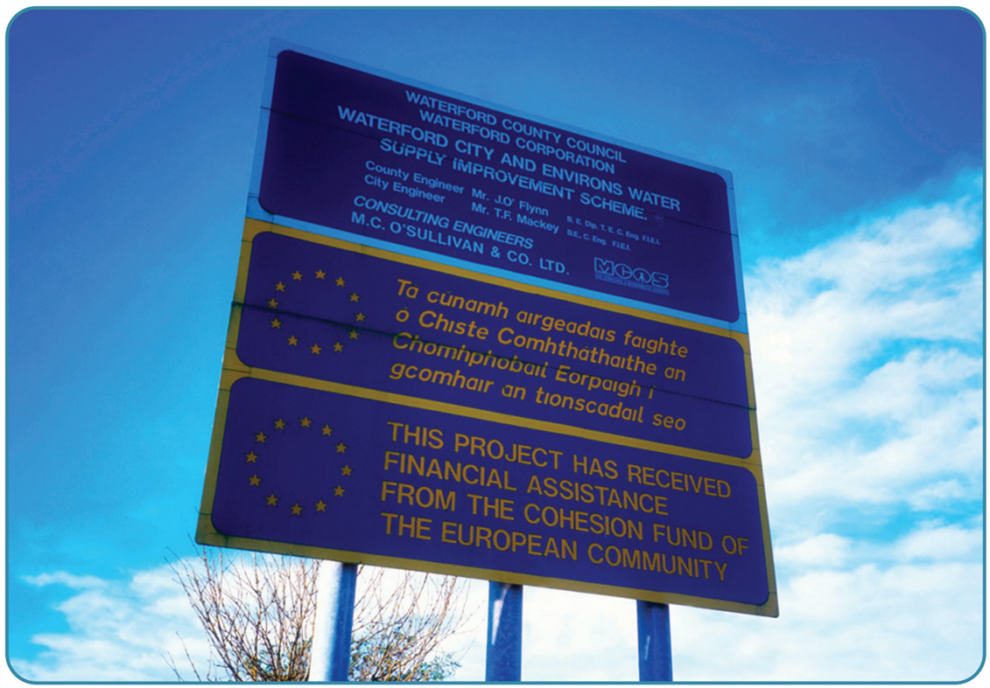
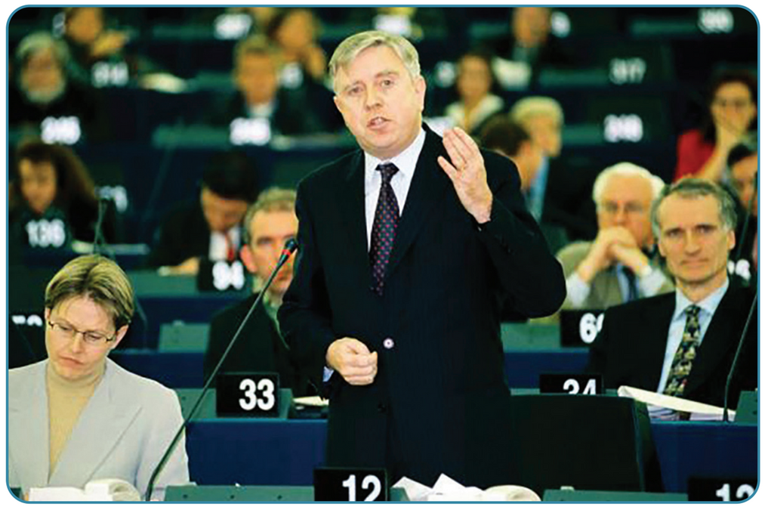
Strand Two & Three: The History of the World
Chapter Thirty-One: The European Union
Diagram taken from Artefact, 2nd Edition by Eimear Jenkinson and Gregg O'Neill (educate.ie)
@MsDoorley

Slide 38
Checkpoint pg. 361 (Artefact, 2nd Edition)
  What organisations did Ireland join in the years after World War II?
  Why did Ireland not join the ECSC or the EEC when they were set up?
  Why did Ireland apply for membership of the EEC in 1961?
  Why was Ireland not able to join until 1973?
  Name two ways that EU membership has benefited Ireland?
  Name two European changes that Ireland has opposed.
Strand Two & Three: The History of the World
Chapter Thirty-One: The European Union
@MsDoorley

Slide 39
1945-Present
Chapter 31
31.6: SUMMARY
31.6: summary
Strand Two: The History of Ireland
@MsDoorley

Slide 40
In this chapter, we have learned that...
  At the end of World War II, Europe lay in ruins. War had devasted the continent twice in the first half of the century. Leaders from across Western Europe were determined to work together to prevent this from ever happening again and to rebuild their countries.
  Cooperation was a gradual process, beginning with meetings and summits where states agreed to work together in areas where they all agreed. From these meetings came the Benelux Agreement, the Council of Europe, the European Convention on Human Rights and the Organisation for European Economic Co-Operation.
  In the 1950s, the focus shifted to deepening economic cooperation. The French government proposed the Schuman Plan to bring the coal and steal industries of France, Germany, and four other countries together under one authority. The ECSC was very successful and the six members expanded it into the European Economic Community in 1957.
  The EEC had its own institutions to run its affairs; the Commission, the Council of Ministers, the Parliament and the Court of Justice.
  Its membership expanded significantly as other countries wanted to enjoy the economic success that the original members had gained. In 2021, the European Union had expanded to 27 members.
  The role and powers of the EEC changed over time as well, for example with the creation of the Common Market for trade, the Common Agricultural Policy, the free movement of goods, services, money and people and the creation of the single currency, the euro. The expansion of the powers of the EEC (and later the EU) took place gradually and was achieved through a series of treaties in the 1980s, 1990s and 2000s.
  Ireland applied for membership of the EEC in 1961, gradually joining in 1973. Ireland has benefitted hugely from membership, with large sums of money coming into the country under the CAP and infastructure funding.
Strand Three: The History of Europe and the Wider World
Chapter Thirty-One: The European Union
@MsDoorley

Slide 41
Reflecting on... European Integration
The process of European integration after World War II has been an extraordinary experiment. It has transformed the continent to create the longest period of continuous peace in 2,000 years. This was achieved gradually by demonstrating the concrete benefits of cooperation to people over a long period of time and with the support of the people who lived in its member states.
Strand Three: The History of Europe and the Wider World
Chapter Thirty-One: The European Union
@MsDoorley

Slide 42
Examination Questions
Strand Three: The History of Europe and the Wider World
Chapter Thirty-One: The European Union
@MsDoorley

Slide 43
Project
Guidelines:
  Length: The depth of your project should reflect about 2-3 weeks of work.
  Sources: Use at least three different sources for your research. These can be books, scholarly articles, or reputable online resources.
  Citations: All information and images that are not your own should be properly cited.
  Mediums: You may choose to present your project in one of the following ways:
    Poster: Your poster should be informative and visually engaging.
    Minecraft or Lego Model: If choosing this option, please also include a brief report explaining your model.
    Painting/Drawing: Your artwork should be accompanied by a description.
    Recycled Materials: Create your model using recycled materials and provide an explanation of your creative process.
Assessment:
Your projects will be assessed based on:
  Research and Content
  Creativity and Presentation
  Understanding of Context
  Adherence to Guidelines
Strand Two & Three: The History of the World
Chapter Thirty-One: The European Union
@MsDoorley

Slide 44
Project
Historical Sites
Historical Figures
Schuman Roundabout, Brussels, Belgium
Palais de l'Europe, Strasbourg, France
Berlaymont Building, Brussels, Belgium
Maastricht, Netherlands
Jean Monnet House, Bazoches-sur-Guyonne, France
Jean Monnet
Robert Schuman
Paul-Henri Spaak
Charles de Gaulle
Patrick Hillery
Peter Sutherland
Máire Geoghan-Quinn
Margaret Thatcher
Strand Two & Three: The History of the World
Chapter Thirty-One: The European Union
@MsDoorley

